Slide 1

Learning to Select Pivotal Samples for Meta Re-weighting
Yinjun Wu, Adam Stein, Jacob Gardner, Mayur Naik
University of Pennsylvania

Slide 2
Outline
Background
Our perspective and solutions
Experiments

Slide 3
Outline
Background
Our perspective and solutions
Experiments

Slide 4
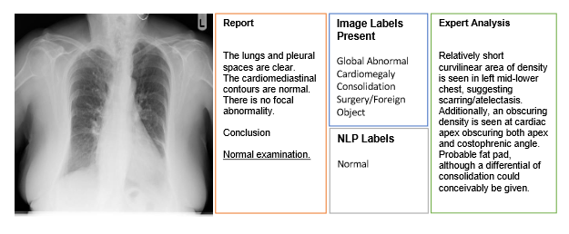

In the presence of dirty labels
Ideally
Reality
Class 1
Class 1
Class 0
Class 0
Class 1
(dirty)
Class 0
(dirty)
~45%!
Chexpert dataset [Irvin et al, 19]

Slide 5
In the presence of dirty labels
Ideally
Reality
Class 1
Class 1
Class 0
Class 0
Class 1
(dirty)
Down-weight dirty one
Class 0
(dirty)
Up-weight clean one
Class 1
Class 1
Class 0
How to re-weight?
Class 0
Class 1
(dirty)
Class 1
(dirty)
Utilize validation set with clean labels!!
Class 0
(dirty)
Class 0
(dirty)
[Ren et al, ICML 18]
[Shu et al, NeurIPS 19]

Slide 6
Reweighting through meta-learning
Meta samples : assumed to be given
Class 1
Class 0
The key idea of [Ren et al, ICML 18] and [Shu et al, NeuIPS 19] (meta-learning):
Meta-reweighting: Jointly learn the weights of each training sample and the model parameters such that the loss on all  and  is minimized
Class 1
(dirty)
Class 0
(dirty)
How to select those meta samples if they don’t exist in the beginning?

Slide 7
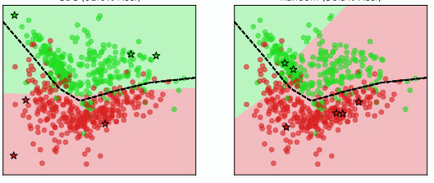
The selection of meta set matters
learned boundary
Expected boundary
learned boundary
Same labeling budget
|
|
|
|
Optimal set of meta samples
=
Randomly selected meta samples
Performance on test set: 87.1% VS 62.9% !
How to select the optimal set of meta samples for label cleaning?
Active learning ?

Slide 8
Outline
Background
Our perspective and solutions
Experiments

Slide 9

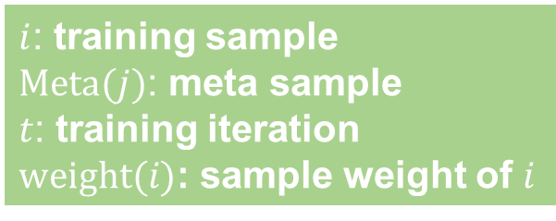
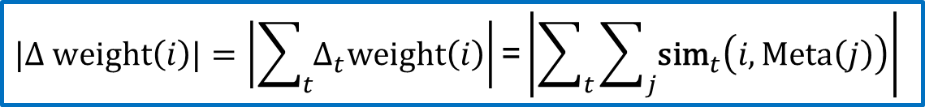
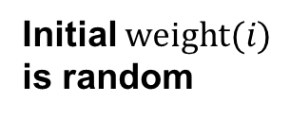
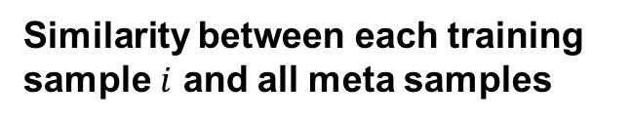
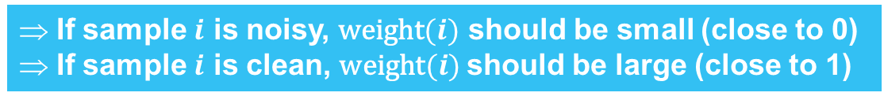
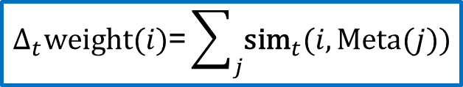
From prior meta-reweighting algorithm
According to [Ren et al, ICML 18] and [Shu et al, NeuIPS 19] , the update of the sample weight at each SGD step:
$i$: training sample
$\text{Meta}(j)$: meta sample
$t$: training iteration
$\text{weight}(i)$: sample weight of $i$
$$∆_{t}\text{weight}(i)\text{=}\sum_{j}{{\text{sim}}_{t}(i, \text{Meta}(j))}$$
Similarity between each training sample $i$ and all meta samples
Overall updates of the sample weight
Sum over all t
$$|∆ \text{weight}\left(i\right)|=\left|\sum_{t}{∆_{t}\text{weight}\left(i\right)}\right|\text{=}\left|\sum_{t}{\sum_{j}{{\text{sim}}_{t}\left(i, \text{Meta}\left(j\right)\right)}}\right|$$
At the end of training, our goal is that:
If sample $i$ is noisy, $\text{weight}(i)$ should be small (close to 0)
If sample $i$ is clean, $\text{weight}(i)$should be large (close to 1)
Initial $\text{weight}(i)$ is random

Slide 10


Our objective function
$$|∆ \text{weight}\left(i\right)|=\left|\sum_{t}{∆_{t}\text{weight}\left(i\right)}\right|\text{=}\left|\sum_{t}{\sum_{j}{{\text{sim}}_{t}\left(i, \text{Meta}\left(j\right)\right)}}\right|$$
Maximize this over all training samples
$$\text{MSSO}≔\text{max}\left(\sum_{i}{\left|\sum_{t}{\sum_{j}{{\text{sim}}_{t}\left(i, \text{Meta}\left(j\right)\right)}}\right|} \right)$$

Slide 11

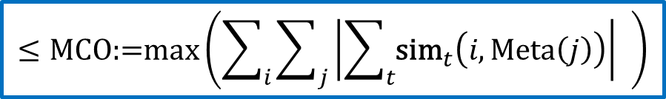

Intractability of MSSO
$$\text{MSSO}≔\text{max}\left(\sum_{i}{\left|\sum_{t}{\sum_{j}{{\text{sim}}_{t}\left(i, \text{Meta}\left(j\right)\right)}}\right|} \right)$$
Enumerate every subset of training samples
=> intractable !
Approximate it with its upper bound
$$≤\text{MCO}\text{:=}\text{max}\left(\sum_{i}{\sum_{j}{\left|\sum_{t}{{\text{sim}}_{t}\left(i, \text{Meta}\left(j\right)\right)}\right|}} \right)$$
$≈$K-means clustering !
Cluster centroids to be solved
Intuitions: Selecting the most representative samples !
MSSO and MCO are close (See Theorem 1)

Slide 12

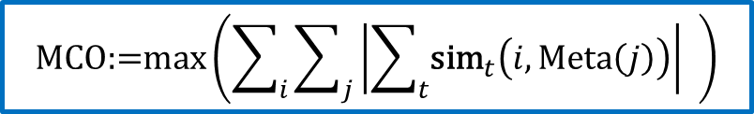


Evaluating MCO
$$\text{MCO}\text{:=}\text{max}\left(\sum_{i}{\sum_{j}{\left|\sum_{t}{{\text{sim}}_{t}\left(i, \text{Meta}\left(j\right)\right)}\right|}} \right)$$
$$=\left\langle \text{Grad}\left(w_{t};i\right),\text{Grad}\left(w_{t};\text{Meta}(j)\right)\right\rangle$$
Weighted k-means clustering (See Algorithm 1)
$$=β_{i,j} \text{cos}\text{(}\text{Grad}\left(w_{t};i\right),\text{Grad}\left(w_{t};\text{Meta}(j)\right)\text{)}$$
| model | = |$\text{Grad}(w_{t};i)$|
performance
GBC
…
RBC: only use the gradient of last layer
GBC: use the gradient of sampled neural layers
RBC
efficiency

Slide 13
Outline
Background
Our perspective and solutions
Experiments

Slide 14
Experiments – quantitative results
Reweighting Cifar100 with real human annotation errors
 | Test accuracy
Random | 49.33
TA-VAAL [Kim et al, CVPR 21] | 44.50
Craige [Mirzasoleiman et al, ICML 20] | 57.92
RBC | 59.25
GBC | 59.25
SOTA active learning methods
Outperform active learning methods

Slide 15
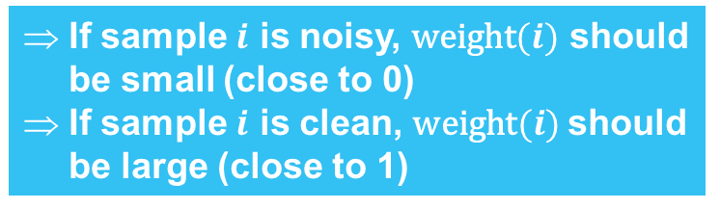
Experiments – quantitative results
Compare sample weights against label dirtiness (dirty=0, clean=1)
At the end of training, our goal is that:
 | AUC score
Random | 0.589
RBC | 0.775
GBC | 0.854
If sample $i$ is noisy, $\text{weight}(i)$ should be small (close to 0)
If sample $i$ is clean, $\text{weight}(i)$should be large (close to 1)
Our methods are better at distinguishing clean samples from noisy ones

Slide 16
Experiments – qualitative results
Projections of the gradients evaluated at each sample on CIFAR-10
meta samples
There exists obvious clustering structures
Our methods can find out meta samples that can cover every cluster

Slide 17
Summary
We defined a problem of selecting meta samples (pivotal samples) for meta reweighting algorithm
We proposed to select meta samples through clustering noisy training samples
We proposed two methods for efficiently calculating the objective functions for clustering
Our experiments show the performance advantage of our methods over baseline methods

Slide 18
Q & A
Github: https://github.com/thuwuyinjun/validation_set_selection
Paper: https://arxiv.org/pdf/2302.04418.pdf
Poster: Posters & Demo IV (Exhibit Hall D, #30)

Slide 19
Reference
[Ren et al, ICML 18] Ren, Mengye, Wenyuan Zeng, Bin Yang, and Raquel Urtasun. "Learning to reweight examples for robust deep learning." In International conference on machine learning, pp. 4334-4343. PMLR, 2018.
[Shu et al, NeuIPS 19] Shu, Jun, Qi Xie, Lixuan Yi, Qian Zhao, Sanping Zhou, Zongben Xu, and Deyu Meng. "Meta-weight-net: Learning an explicit mapping for sample weighting." Advances in neural information processing systems 32 (2019).
[Kim et al, CVPR 21] Kim, Kwanyoung, Dongwon Park, Kwang In Kim, and Se Young Chun. "Task-aware variational adversarial active learning." In Proceedings of the IEEE/CVF Conference on Computer Vision and Pattern Recognition, pp. 8166-8175. 2021.
[Irvin et al, 19] Irvin, Jeremy, Pranav Rajpurkar, Michael Ko, Yifan Yu, Silviana Ciurea-Ilcus, Chris Chute, Henrik Marklund et al. "Chexpert: A large chest radiograph dataset with uncertainty labels and expert comparison." In Proceedings of the AAAI conference on artificial intelligence, vol. 33, no. 01, pp. 590-597. 2019.
[Tobi et al, 19] Olatunji, Tobi, Li Yao, Ben Covington, and Anthony Upton. "Caveats in generating medical imaging labels from radiology reports with natural language processing." In International Conference on Medical Imaging with Deep Learning--Extended Abstract Track. 2019.

Slide 20




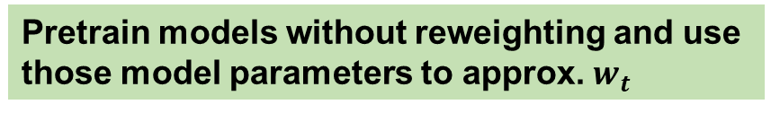
Evaluating MCO
$$\text{MCO}\text{:=}\text{max}\left(\sum_{i}{\sum_{j}{\left|\sum_{t}{{\text{sim}}_{t}\left(i, Meta\left(j\right)\right)}\right|}} \right)$$
Enumerate all time steps
Sample a few $t$ rather than use all of them
To be solved
Unknown!!
Meta-reweighting
Pretrain models without reweighting and use those model parameters to approx. $w_{t}$
$$Meta(j)$$
$$w_{t}$$
Unknown clean labels
Split the gradient into label-free part and label-dependent part (See Theorem 2)

Slide 21
Meta samples selected by GBC
Randomly selected meta samples
Performance on test set: 92.0% VS 56.3% !

